Slide 1
Hyper-parameter Tuning
Prof. Dr. Umberto Michelucci
umberto.michelucci@toelt.ai
umberto.Michelucci@hslu.ch

Slide 2
Problem description
(Almost) any ML model has many parameters that can vary, for example
Number of neurons in layers in NN
Depth of a decision tree
Degree of a polynomial
Learning rate
Etc.
How can we choose the best parameters (a.k.a. the parameter that gives the model with the best performance?)

Slide 3
Solution
The only possibilty we have is to train multiple models with different set of parameters and compare their performance → then choose the set of parameters that gives the best performance.
How can we do this efficiently (by minimising computing time for example)?

Slide 4
Let us be more precise…
Some terminology

Slide 5
Parameters vs. hyper-parameters
First of all a definition
A hyperparameter is a parameter that is used in the ML model design or learning process that is not changed by the training process itself * (more specifically from the training data).
Thus a parameter is any other “parameter” that is changed during the training process (for example the weights of a NN). Note that the term “hyper-parameter” is almost uniquely used in the neural network contexts.
* Learning rate modification strategies exists, but they are independent of the training data.

Slide 6
Hyper-parameters Examples
- Learning rate (continous parameter)
- Number of layers in a neural networks (discrete number of choices)
- Number of neurons in a neural networks (discrete number of choices)
- Activation functions (finite number of choices)
- Data normalisation approach
- etc.
An hyper-parameter is not necessarily a number!

Slide 7
Hyper-parameters Types
Parameters that are continuous real numbers, or in other words that they can assume any value. Example: learning rate, regularization parameter, etc.
Parameters that are discrete but can theoretically assume an infinite number of values. Example: number of hidden layers, number of neurons in each layer or number of epochs.
Parameters that are discrete and can only assume a finite number of possibilities. Example: optimizer, activation function, learning rate decay method

Slide 8
Hyper-parameter type 3
For category 3 there is not much to do except trying all possibilities. They typically will change completely the model itself, and therefore is impossible to model their effect, therefore making a test the only possibility. This is also the category where experience may help the most!
Example: Adam is typically the most efficient optimiser, so is a good to start with it.

Slide 9
Black-Box Optimisation
Some theoretical underpinnings of hyper-parameter tuning

Slide 10
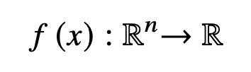
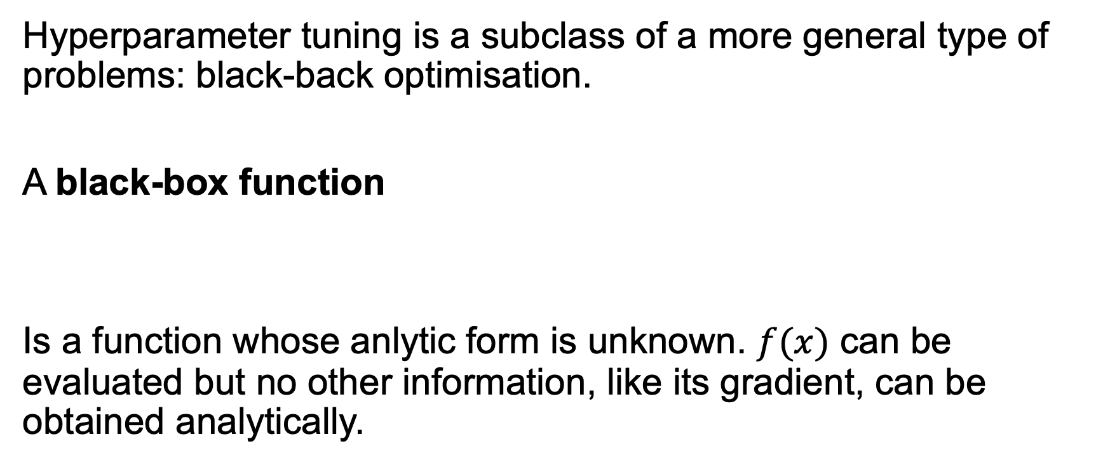
Black-Box Optimisation
Hyperparameter tuning is a subclass of a more general type of problems: black-back optimisation.
A black-box function
Is a function whose anlytic form is unknown. $f(x)$ can be evaluated but no other information, like its gradient, can be obtained analytically.

Slide 11
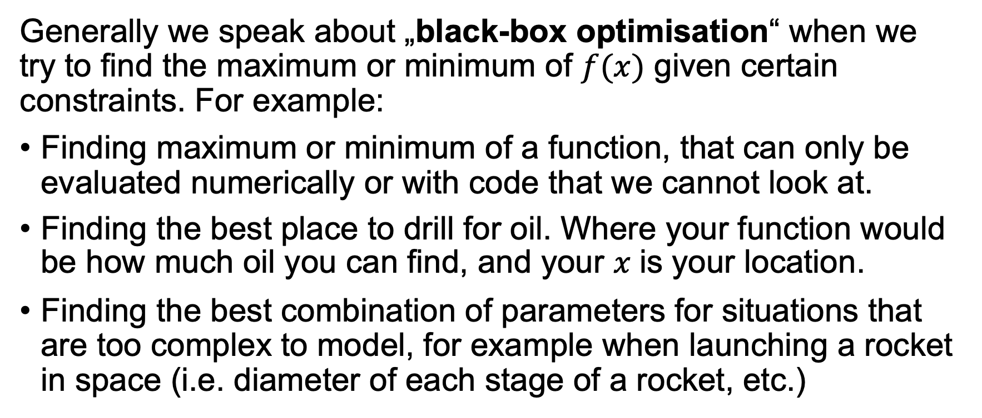
Black-Box Optimisation
Generally we speak about „black-box optimisation“ when we try to find the maximum or minimum of $f(x)$ given certain constraints. For example:
Finding maximum or minimum of a function, that can only be evaluated numerically or with code that we cannot look at.
Finding the best place to drill for oil. Where your function would be how much oil you can find, and your 𝑥 is your location.
Finding the best combination of parameters for situations that are too complex to model, for example when launching a rocket in space (i.e. diameter of each stage of a rocket, etc.)

Slide 12
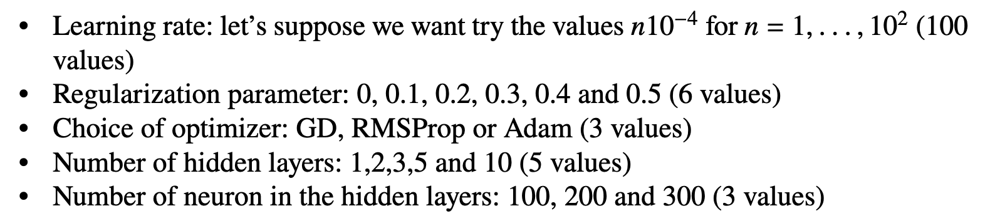
Black-Box Optimisation – why is this a problem…
Suppose we are working with NNs, and we want to test multiple parameters, for example
We will need to train our networks 100 × 6 × 3 × 5 × 3 = 27000 times!! → Clearly not feasible.

Slide 13
Black-Box Optimisation – why is this a problem…
If your training takes 5 minutes you will need 13.4 weeks of computing time!
If the training takes one day for example, you will need 73.9 years of computing time to try all possibilities! Even if you want to try only 10 different set of hyper-parameters, you will need 10 full days of computing time (if you pay for it by the minute it can be very expensive).

Slide 14
Black-Box Optimisation – Types of functions
There are two types of black-box functions
Cheap functions: functions that can be evaluated thousands of times. For example evaluating the function could be very fast, or it could be cheap from an economic point of view.
Costly functions: functions that can only be evaluated few times, usually less than 10-100 times. A classical example is how much oil we get if we drill in a given location. Getting this information costs time and especially lots of money, so drilling to get the amount of oil in a specific location can be done only a few times before it gets not sustainable anymore from an economic point of view.

Slide 15
Black-Box Optimisation – Neural Networks
Neural networks are almost always, especially in the deep learning world, costly functions.

Slide 16
Black-box Optimisation – an example
A numerical example to make the theory more real

Slide 17
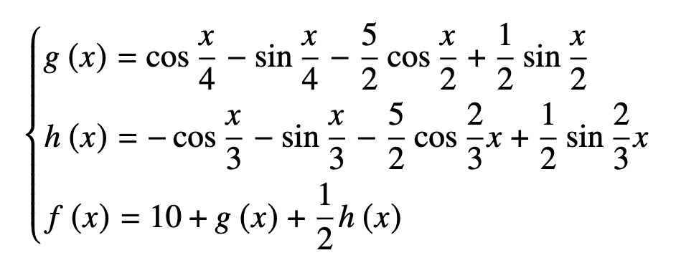


The black-box function $f(x)$
Let’s imagine we do not know anything about this function $f\left(x\right)$ and we want to find its maximum.
Fundamental Mathematical Concepts for Machine Learning in Science, Umberto Michelucci, Springer Nature (available in 2024)

Slide 18
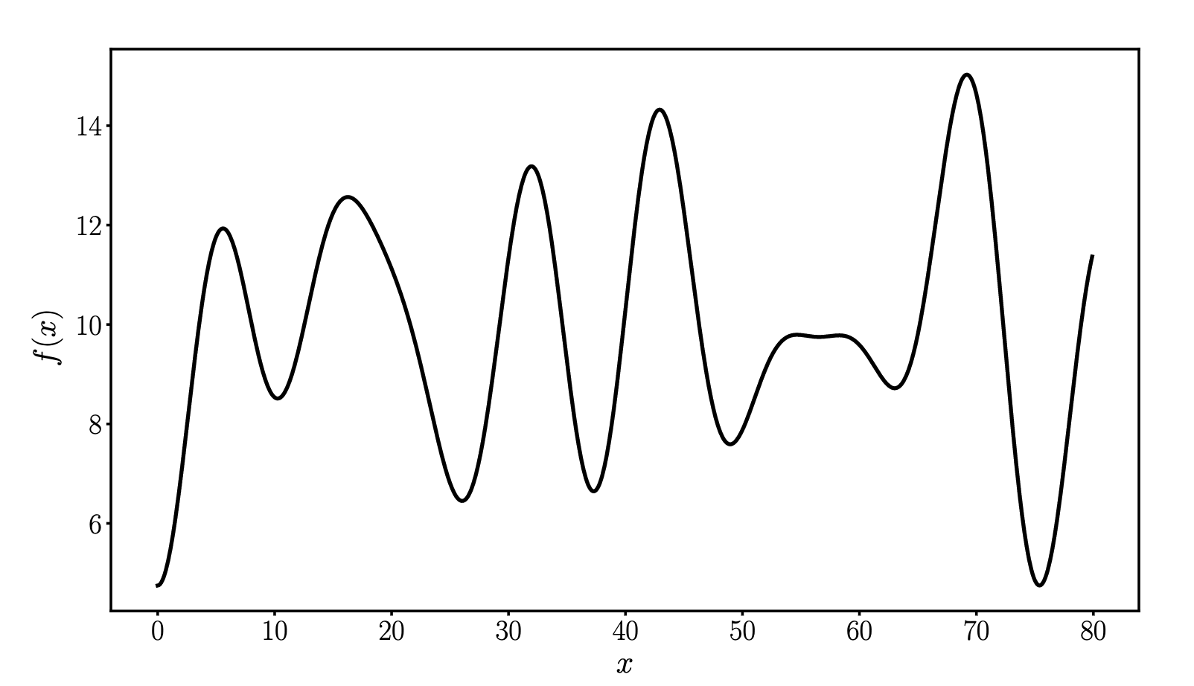
The black-box function $f(x)$
Fundamental Mathematical Concepts for Machine Learning in Science, Umberto Michelucci, Springer Nature (available in 2024)

Slide 19
Grid Search
The less intelligent method for black-box optimisation.

Slide 20
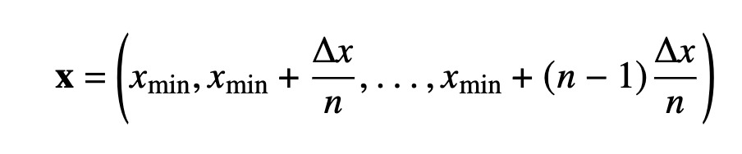
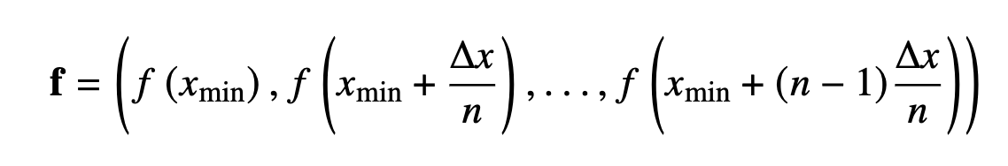
Grid Search
we want to find the maximum of the function 𝑓 (𝑥) between two 𝑥 values 𝑥_{min} and 𝑥_{max.}
What we would do is simply take 𝑛 points equally spaced between 𝑥_{min} and 𝑥_{max} and evaluate the function at those points.

Slide 21
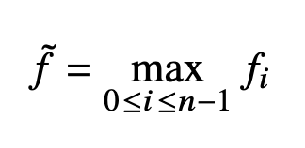
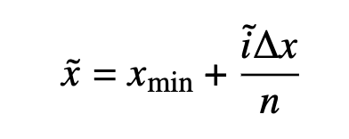
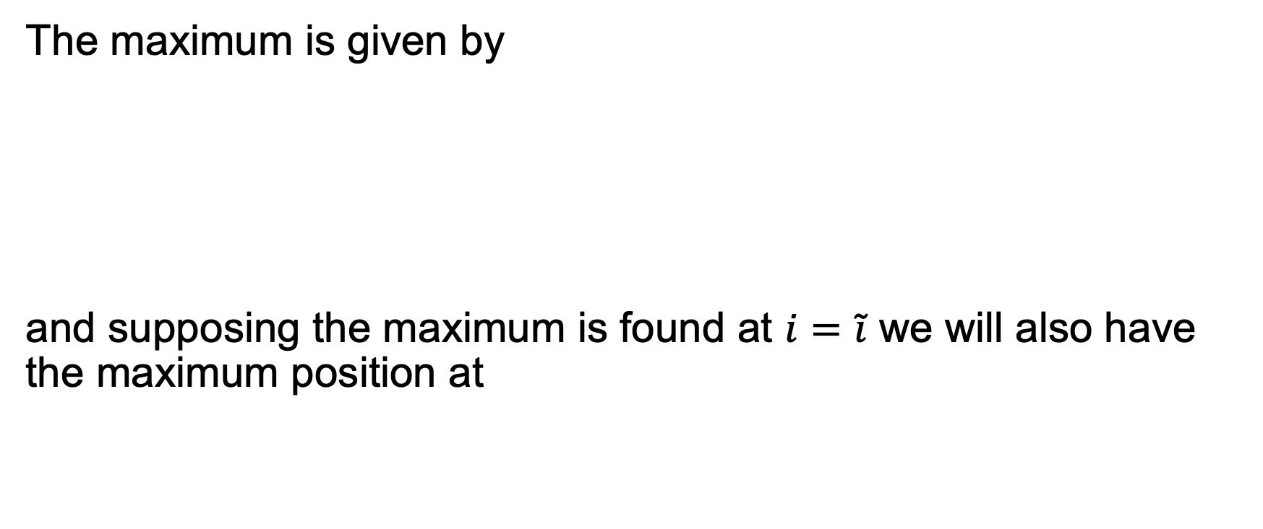
Grid Search
The maximum is given by
and supposing the maximum is found at $i=\tilde{i}$ we will also have the maximum position at

Slide 22
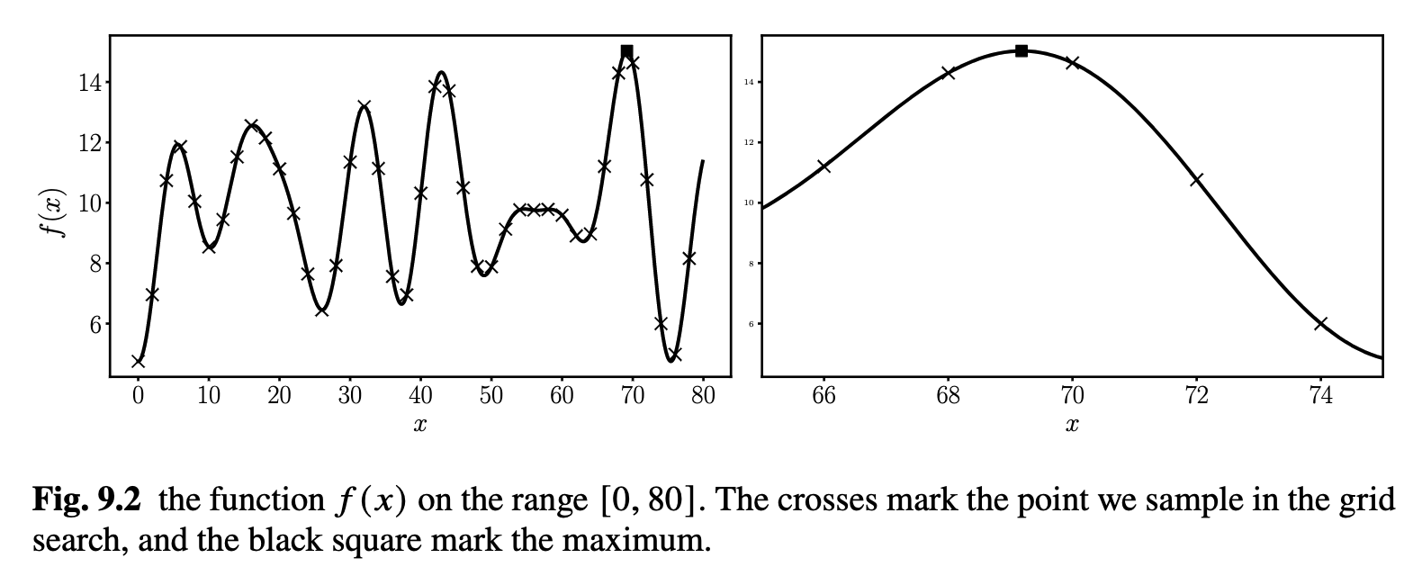
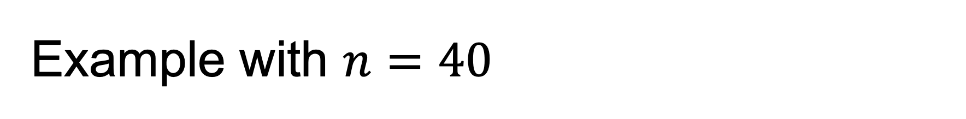
Example with $n=40$
Fundamental Mathematical Concepts for Machine Learning in Science, Umberto Michelucci, Springer Nature (available in 2024)

Slide 23
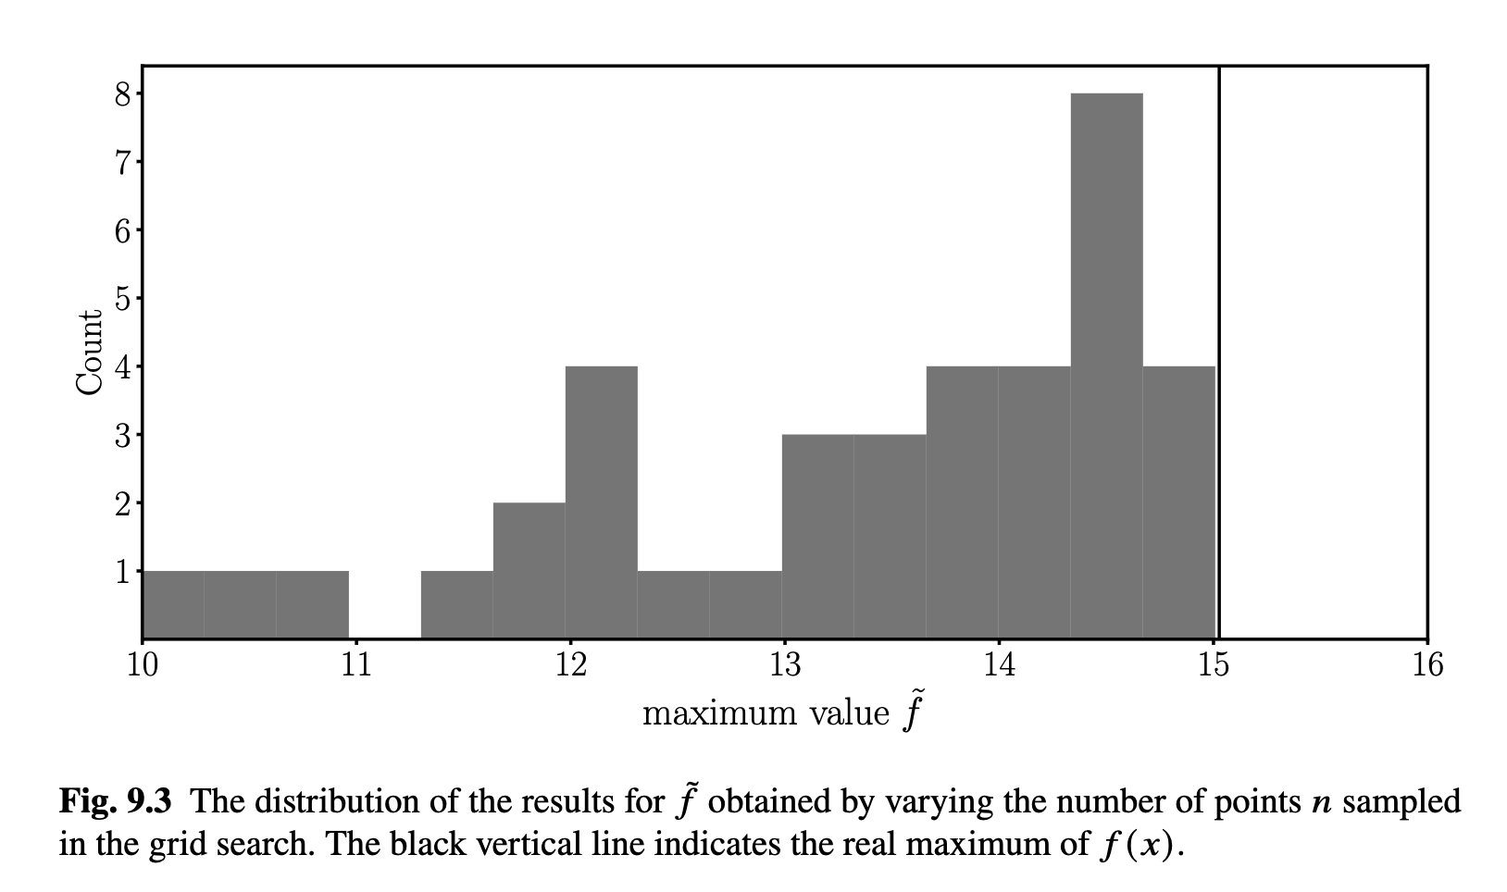
Example with different number of points.
Fundamental Mathematical Concepts for Machine Learning in Science, Umberto Michelucci, Springer Nature (available in 2024)

Slide 24
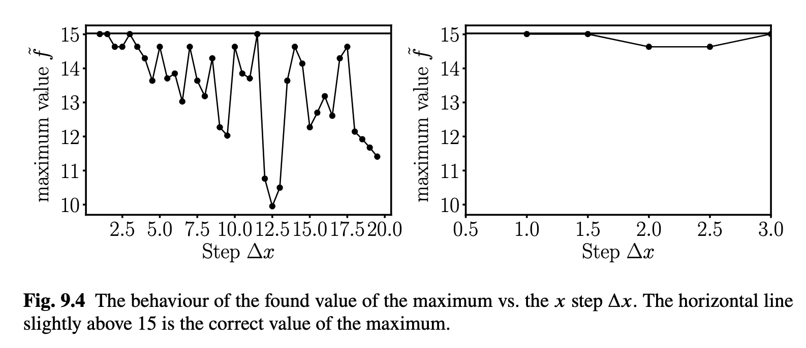
Example with $n=40$
Fundamental Mathematical Concepts for Machine Learning in Science, Umberto Michelucci, Springer Nature (available in 2024)

Slide 25
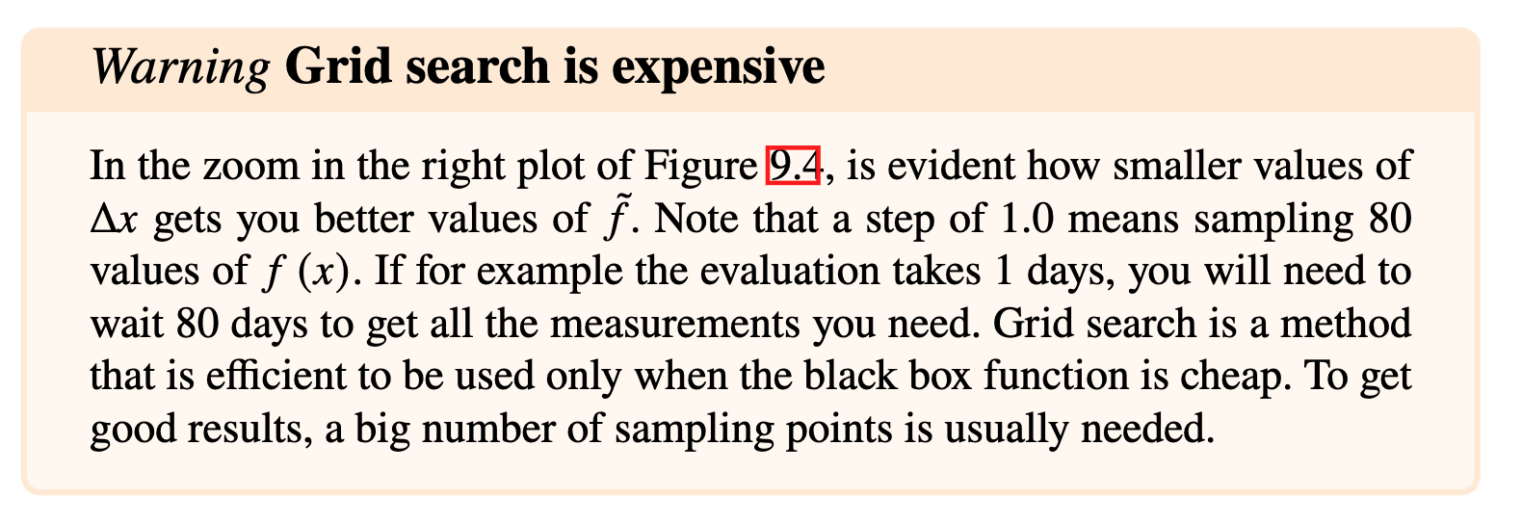
Grid Search is Expensive
Fundamental Mathematical Concepts for Machine Learning in Science, Umberto Michelucci, Springer Nature (available in 2024)

Slide 26
Random Search
The more efficient method for black-box optimisation.

Slide 27
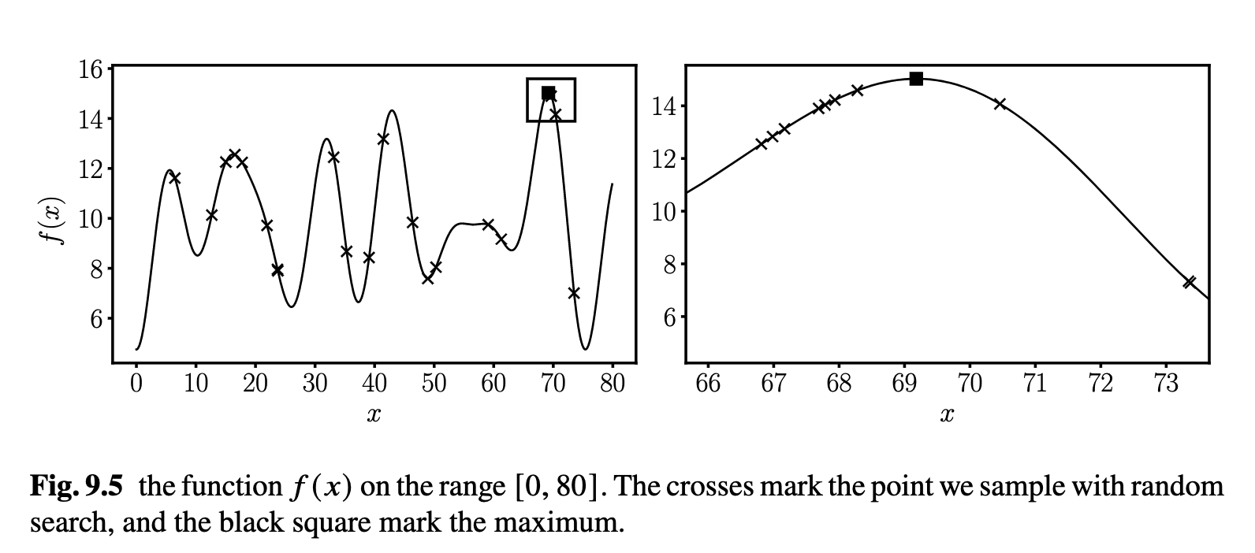
Random Search
Instead of sampling 𝑥 points regularly in the range (𝑥min, 𝑥max) you sample the points randomly (example below with 80 points).
Fundamental Mathematical Concepts for Machine Learning in Science, Umberto Michelucci, Springer Nature (available in 2024)

Slide 28
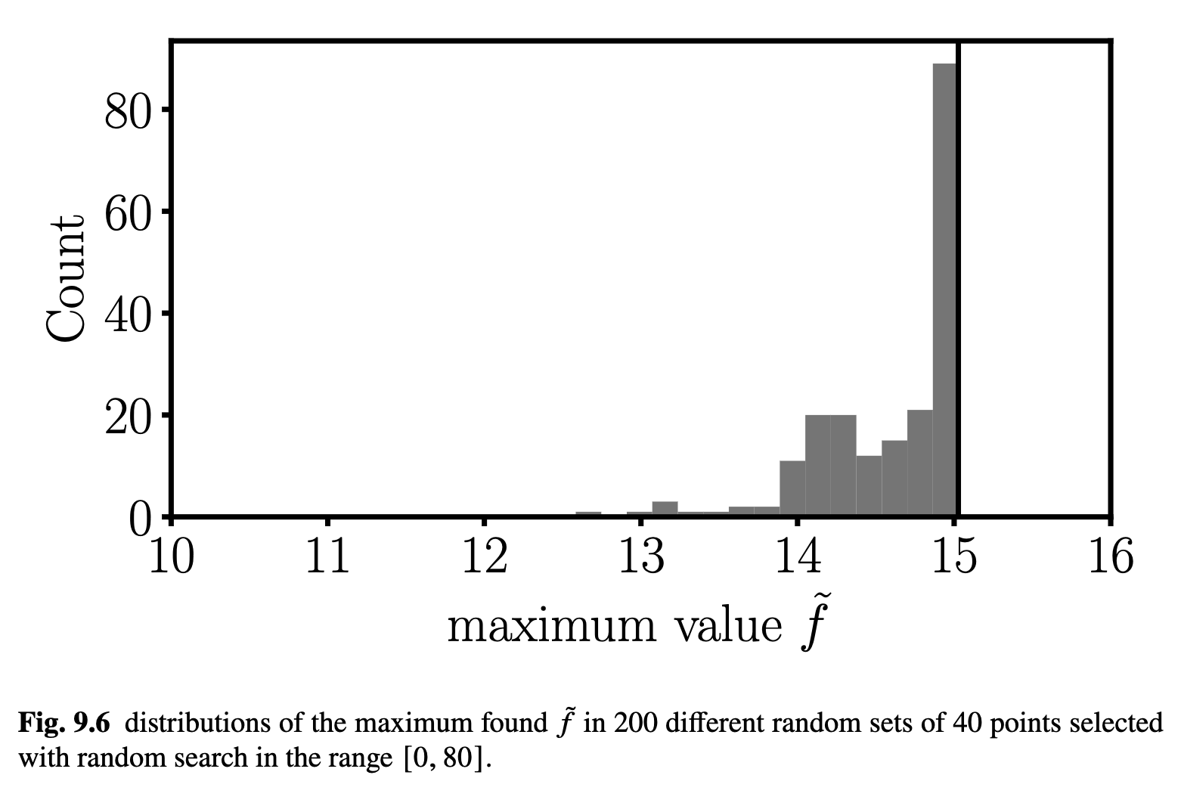
Random Search
Fundamental Mathematical Concepts for Machine Learning in Science, Umberto Michelucci, Springer Nature (available in 2024)

Slide 29
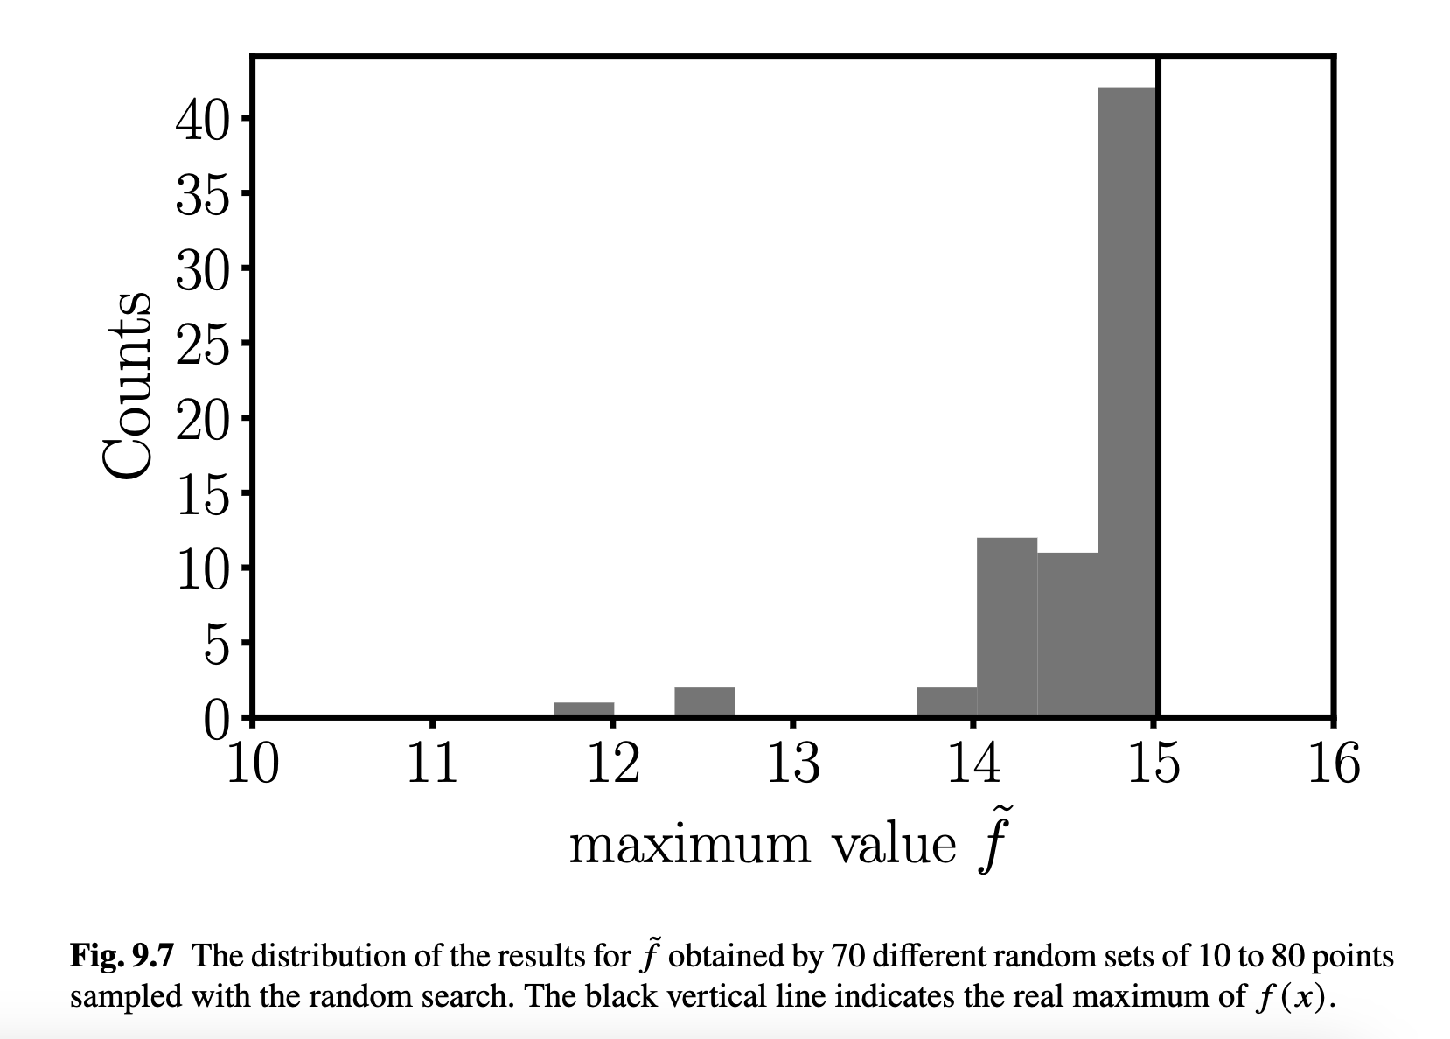
Random Search
Is easy to see how on average random search is better than grid search. The values you get are consistently closer to the right maximum.
Fundamental Mathematical Concepts for Machine Learning in Science, Umberto Michelucci, Springer Nature (available in 2024)

Slide 30
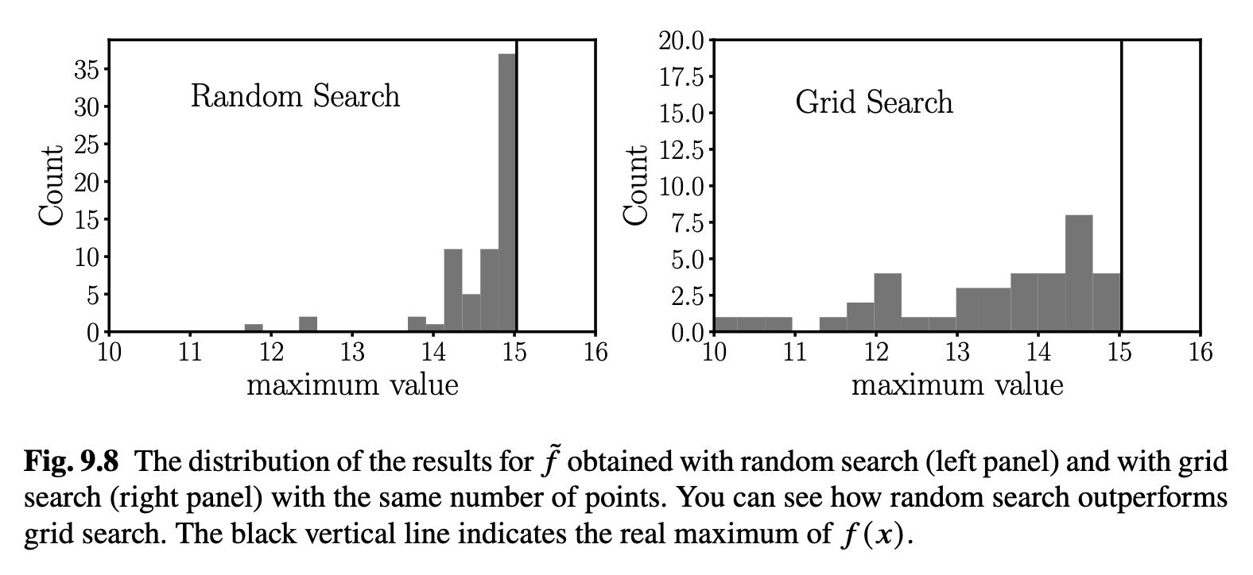
Random Search vs. Grid Search
Fundamental Mathematical Concepts for Machine Learning in Science, Umberto Michelucci, Springer Nature (available in 2024)

Slide 31
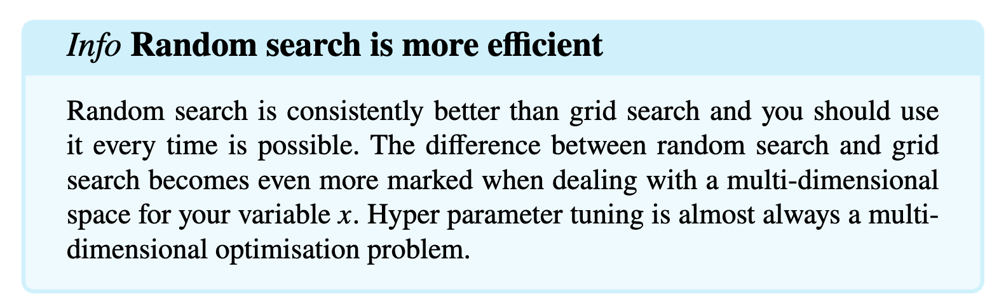
Random Search is Expensive
Fundamental Mathematical Concepts for Machine Learning in Science, Umberto Michelucci, Springer Nature (available in 2024)

Slide 32
Coarse to fine optimisation
Fine tuning of hyper-parameter search

Slide 33
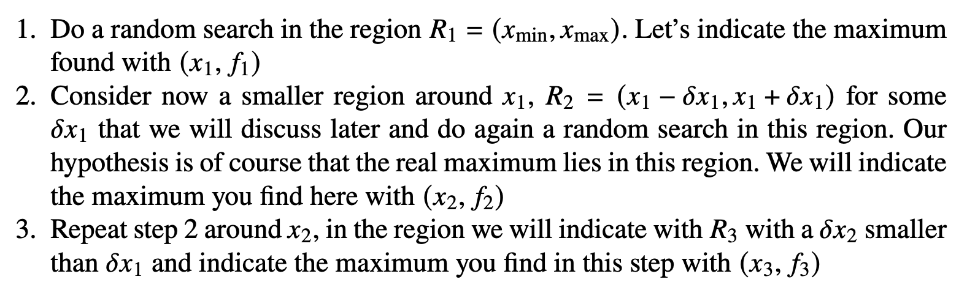
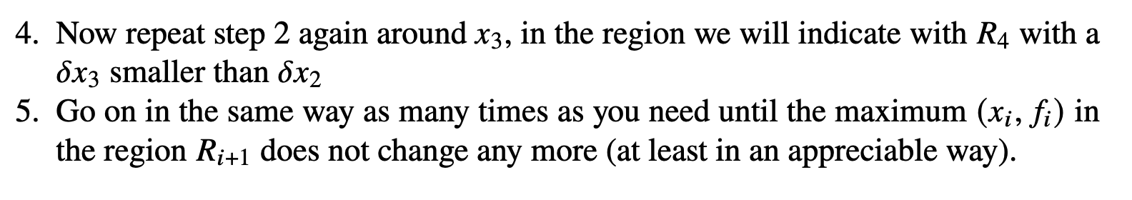
Coars-to-fine optimisation algorithm

Slide 34
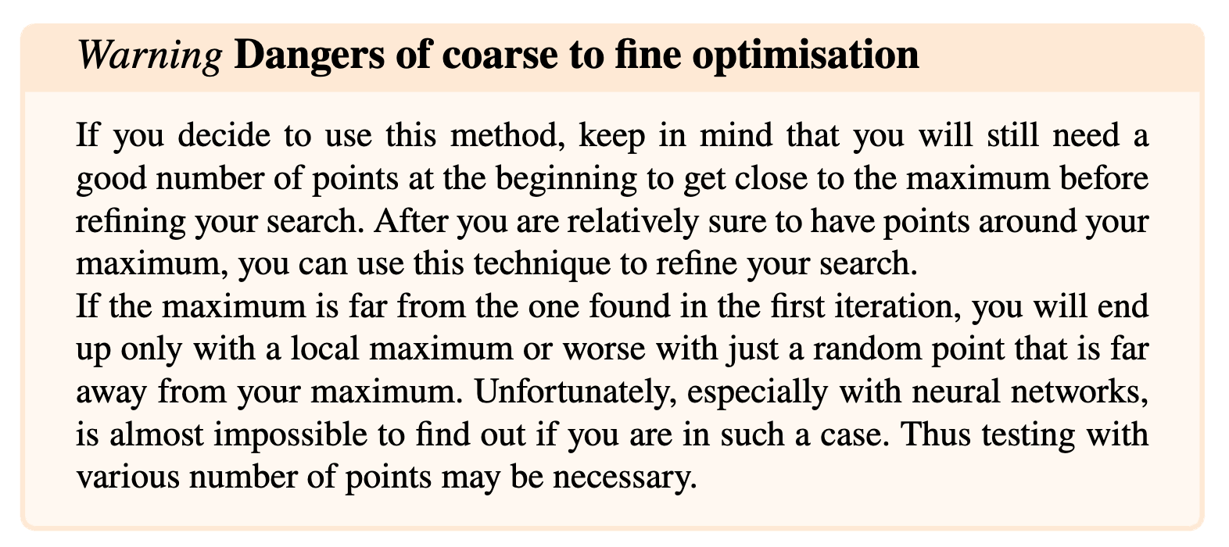
Coarse to fine optimisation - warning
Fundamental Mathematical Concepts for Machine Learning in Science, Umberto Michelucci, Springer Nature (available in 2024)

Slide 35
Sampling on a logarithmic scale
Another small detail about hyper-parameter search

Slide 36
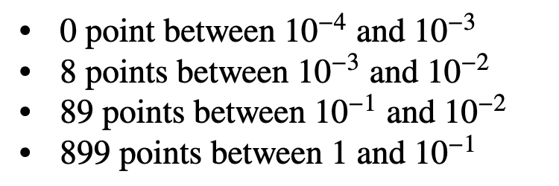
Sampling on a logarithmic scale
Let us suppose you want to find the best value for the learning rate for your model, and you decide to test values from 10⁻⁴ to 1
Probably the best values are between 10⁻³ and 10⁻⁴
Now let us suppose you are working with grid search and let us suppose you sample 1000 points. You will get:

Slide 37
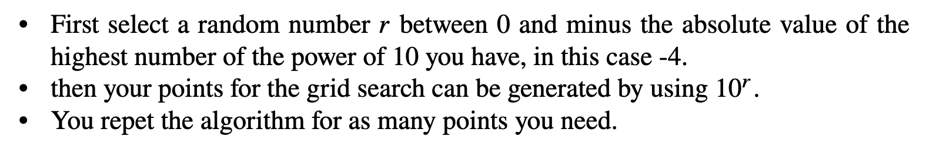
Sampling on a logarithmic scale
You may want the same number of points between 10⁻⁴ and 10⁻³, 10⁻³ and 10⁻², 10⁻¹ and 10⁻² and 10⁻¹ and 1
To do that you can use the following algorithm.

Slide 38
Tuning with Tensorflow/Keras
Keras tuner, an easier to use system

Slide 39
Keras Tuner
When working with Keras, the ”Keras Tuner” is an integrated hyper-parameter tuner in Keras (more in the hands-on).

